Slide 1
Employee Data Analysis using Excel
STUDENT NAME:S DIVAHAR
REGISTER NO:312201023
NAAN MUDHALVAN USERNAME:asunm110312201023
DEPARTMENT:B.COM ACCOUNTING AND FINANCE
COLLEGE:DRBCCC HINDU COLLEGE

Slide 2
PROJECT TITLE
Employee workforce Analysis using Excel

Slide 3


AGENDA
Problem Statement
Project Overview
End Users
Our Solution and Proposition
Dataset Description
Modelling Approach
Results and Discussion
Conclusion
3/21/2024 Annual Review

Slide 4

PROBLEM STATEMENT
The main reason for this analysis is to find the work force of the company

Slide 5

PROJECT OVERVIEW
This project is analysis of number of workers in the company so that the company would be able to find out the total workforce of the department wise to the types of employees workers in a company
.

Slide 6

WHO ARE THE END USERS?
The end users of this data analysis will be the company and the company manager
This analysis helps to find out the workforce of the company with number types of workers in the company with accurate data.
By this they can analyze the work force of the company

Slide 7

OUR SOLUTION AND ITS VALUE PROPOSITION
Conditional formatting : - missing values
filter remove
Formula performance for summing up
Pivot table-For easy transformation of large data
Pivot summary
line graph-Data visualization

Slide 8
Dataset Description
Employee data- edunet dashboard total 9 features from a to h 3 features were taken
Name-text employee type-text department-text

Slide 9

THE "WOW" IN OUR SOLUTION
The wow in our solution is the visual representation of the data which will be done with the type of workers in the company.
3/21/2024 Annual Review
9

Slide 10
MODELLING
Data collection
Data cleaning
Filtering of data
Selecting the required fields
Converting them into a pivot table
Summarising the data
Getting the results from the data after arrangement
Getting the 3D graph
Doing the data visualization
10

Slide 11
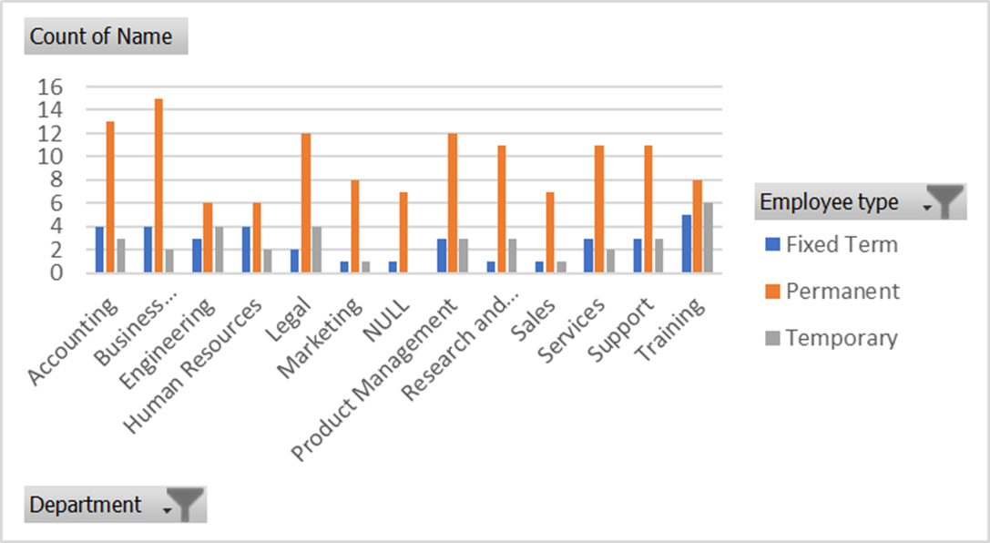
RESULTS
11

Slide 12
conclusion
This analysis will help to know the company about the workforce of the company department wise so that they can have a complete record of the peoples count in the company and do all the necesary works as per the work force

